Slide 1
Dev Days – Performance and Memory Management
Adam Kemp
Staff Software Engineer
LabVIEW Compiler Team

Slide 2
Goals
Understand the LabVIEW Execution System
Learn to improve performance by:
Reducing data copies
Reducing overall memory usage
Understand VI Execution Properties

Slide 3
The LabVIEW Execution System
The execution system is the part of LabVIEW which is responsible for actually running your code
Enables automatic parallelism
Unique to LabVIEW
Other languages require manual thread management
Notes:
The LabVIEW execution system is what enables your code to have automatic parallelism. In other languages you have to manage multiple threads manually if you want to run code in parallel, but the LabVIEW compiler and execution system work together to automatically run your code in parallel when possible. Most of the time the details of the execution system are unimportant because it will do the right thing for you without intervention, but sometimes it helps to understand how the execution system works so that you can improve performance.

Slide 4
The LabVIEW Execution System
Works like a thread pool
A queue of jobs
A set of threads pulling jobs off the queue
Jobs (“queue elements”) are pieces of VI code to execute
One queue per execution system
UI
Standard
Instrument I/O
Data Acquisition
Other 1
Other 2
Timed loops
Notes:
A LabVIEW execution system works like a thread pool. A thread pool is a collection of threads which work together to complete a set of jobs which are pulled from a shared queue. In LabVIEW the jobs are called “queue elements”, and each one represents a piece of code from a VI which needs to be executed.
There are actually 6 common execution systems in LabVIEW, and each one has its own separate queue. Additionally, each timed loop has its own unique execution system.

Slide 5
LabVIEW Execution System
Each execution system has multiple threads
Exception: UI has only one thread

Slide 6
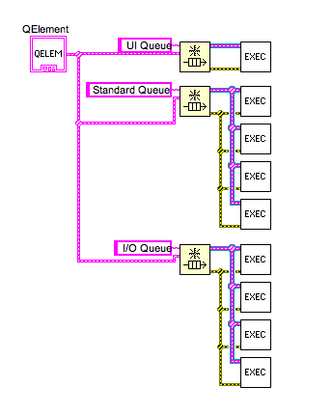
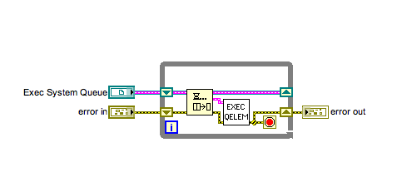
LabVIEW Execution System
Notes:
This is a LabVIEW mockup of how the execution system works. For each execution system (three are shown here) we create a queue. The data put on that queue represents pieces of compiled VI code to run. When part of a VI is ready to run it is put on one of the execution system system queues.
Each execution system has one or more threads. Each of those threads has a loop which pulls elements off the queue and executes the code for that element. The UI thread has only one of these threads, but the other execution systems have more than one thread all sharing the same queue. When code on a VI runs in parallel it is being handled by different threads of its execution system.

Slide 7
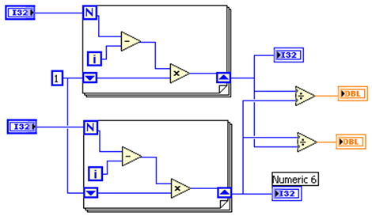
LabVIEW Clumping Algorithm
Clump 0
Clump 1
Clump 0
Clump 2
Notes:
In addition to the preemptive multitasking of the operating system, LabVIEW employs a cooperative multitasking system. During compilation, LabVIEW analyzes VIs to locate groups of nodes that can execute together in what are called clumps. Each priority and execution system combination has a run queue data structure that retains which clumps can run together. When the execution system activates a thread, the execution system retrieves and executes a clump from the run queue. When the execution system finishes executing, it stores additional clumps that meet the input conditions on the run queue. This allows the block diagram to execute in any of the available execution threads. If the block diagram includes enough parallelism, it can simultaneously execute in all threads.
LabVIEW does not permanently assign clumps of code to a particular thread. LabVIEW may execute a clump using a different thread the next time you run the VI.
Each clump produces a section of code that can be scheduled by LabVIEW. Within a clump, LabVIEW offers no parallelism. Between clumps, LabVIEW can multi-task using its executions system.

Slide 8
LabVIEW Clumping Algorithm
Clump 1
Top For Loop
Indicator is updated
Clump 0 Scheduled
Sleep...
Clump 1 Sleeping
Clump 0
Start of diagram:
Reads controls, then schedules Clumps 1 and 2
Then sleeps...
Completion of diagram:
Divide nodes, display of
indicators, then VI exit.
Clump 0 Sleeping
Clump 2
Bottom For Loop
Indicator is updated
Clump 0 Scheduled
Sleep...
Clump 2 Sleeping
Notes:
The clump illustrated above represents both the beginning and the end of the block diagram. The clump is “asleep” while the two For Loops execute, and it is “awakened” to complete the VI (two divide functions).
The generated code for a VI presumes the existence of a LabVIEW execution system. Each clump has a record in the VI’s data space called a QElement. The QElement may be placed on a queue called the “runQ”, which is used by the LabVIEW execution system to schedule the associated sections of code.

Slide 9
Going to sleep
When a node “goes to sleep” it puts itself on a wait queue and then returns to the execution system
E.g., Queues, SubVI calls, debugging, etc.
When it is done waiting it is taken off the wait queue and put back on the execution queue
Sometimes VIs will “yield” execution by stopping their execution and going back on the queue
E.g., While loops
Queue elements track progress so they can pick up where they left off
Notes:
Often a node in LabVIEW code will have to wait for something before it can continue. For instance, queues or SubVIs may be in use by another thread, or you might be single stepping while debugging. In these cases the queue element for that VI code will be put into a wait queue handled by whatever it is waiting on. After it is put on the wait queue, the VI code returns to the execution system thread it was running on so that another piece of code can run. This is called cooperative multitasking. When the piece of code on the wait queue is ready to run again it is taken off of the wait queue and then put back on to the execution system queue. Eventually (perhaps immediately) that queue element will be taken off the execution queue again and run.
Sometimes VIs will cease execution voluntarily in order to allow other code to run. This prevents a long loop from taking up all of the execution time. When this happens the VI code simply returns to the execution system with instructions to immediately place it back on the queue. After other code has gotten a chance to run that piece of VI code will again be taken off the queue and run.
Any time a piece of VI code has to go to sleep for some reason the queue element for that code keeps track of where it left off so that next time it is scheduled it can start in the same place.

Slide 10
Preferred Execution Systems
Some nodes must run in UI thread
Each VI can specify a preferred execution system
Default is “Same as caller”
Notes:
Some nodes have a preferred execution system. The most common preferred execution system is the UI thread. Some nodes must run on the UI thread. For instance, VI Server property nodes and VI Server invoke nodes and open VI reference nodes must run in the UI thread. (This restriction does not apply to property/invoke nodes used to access DAQ, LV classes or other types that use the property/invoke nodes.) In addition, each VI can specify a preferred execution system. The default is “Same as caller”, which means that the VI can run in any execution system.

Slide 11
Switching Execution Systems
Happens when code needs to run in a different execution system than the caller or previous code
Most common with UI code
Switching execution systems can cause performance problems
Requires going to sleep and then waking up on another execution system thread
Switching back takes just as long
Can sometimes set Preferred Execution System to avoid extra switches
Avoid unnecessary UI code
Notes:
When a node wants to run but is in the wrong execution system it causes the queue element to “go to sleep” and wake back up in another execution system. Recall that this means that the code will stop executing and put itself on a queue for the execution system it wants to run on. When that other execution system has time it will pull the element back off the queue and execute it. This transition takes time, and therefore it can be a cause for performance issues.
To avoid this you should try to avoid unnecessary UI code (like VI server properties) and use “Same as caller” for SubVIs. There are two cases where you might want to use a specific preferred execution system for a VI:
If the VI has UI code in it then that code must run in the UI thread. When you use “same as caller” you are likely to end up running in an execution system other than the UI thread. This means that the VI will have to switch execution systems to get to the UI thread. Then, because the VI has to return to the same execution system it started in before returning to the caller, it will have to switch back. If this happens in a loop then it can significantly impact performance. If you instead mark that VI as preferring the UI thread then the caller can switch to the UI thread before the call. This may mean that the switch happens only before and after the loop rather than every time.
If the VI has a long-running higher priority loop in it for handling a task like data acquisition then you can mark that VI to run in one of the other execution systems (Instrument I/O, Data Acquisition, Other 1, or Other 2) so that it does not have to compete with other Vis for the execution system’s time. Remember that if you are not running on a realtime OS you still have to worry about the OS scheduler. Using a timed loop to control the priority will be more reliable, and doing so on a realtime OS is the most reliable way to ensure that your code runs at the correct priority.

Slide 12
Priorities
SubVI priorities affect the priority of the queue elements for that VI within an execution system
Higher priority queue elements are pulled off first
The priority setting does not affect the priority of the execution system thread itself
The OS may preempt the whole thread to run the thread for another execution system (or other process)
Use Timed Loops to control priority more reliably

Slide 13
Subroutine Priority
Not a real priority
Reduces execution system overhead for very commonly called code
Forces the whole VI to be in a single clump
Prevents the VI from ever going to sleep
No calls which may sleep (like queue operations)
No switching execution systems
Can only call other subroutine VIs
No parallelism
Can be set to “Skip Subroutine Call If Busy”
Usually not recommended
Notes:
The Subroutine priority setting is not a real priority. Rather than change the priority of the queue elements, the subroutine priority causes the entire VI to be a single clump which is guaranteed not to go to sleep once it starts to execute. This means that you cannot call any functions which may cause the VI to go to sleep within a subroutine VI, and you cannot switch execution systems within the VI. You can only call other subVIs which are also marked as subroutine priority. All code which runs within the subroutine VI happens in series: there is no parallelism in a subroutine VI.
One interesting use of a subroutine VI is that you can mark the call to a subroutine VI to skip the call if it is busy (that is, if its dataspace is already in use).

Slide 14
Inline VIs
Preferred replacement for Subroutine Priority
Entire block diagram is inserted into caller when the caller is compiled
Zero call overhead
Can still contain parallelism
Allows for more compiler optimizations
Limitations:
No front panel access
Not all nodes allowed
Forces callers to recompile every time the SubVI is modified

Slide 15
Blocking a thread
External code (Call Library Nodes, CINs, .Net, ActiveX) will block a thread for the duration of the call
C code does not use LabVIEW’s queue elements, so if it blocks then the whole thread must wait.
No other VI code can run while waiting.
Usually cannot be aborted
See “Callbacks” tab of Call Library Node
Notes:
While LabVIEW’s execution system is based on cooperative multithreading, code written in other languages is not. This means that when you call into external code from LabVIEW that code will consume the execution thread until the call is complete. If the external code has to wait for a mutex or for some other reason then no other VI code can run on that execution system thread while it is waiting. Also, in most cases external code cannot be aborted, so if you try to abort a VI while it is running external code it will have to wait for the call to complete before the VI is fully stopped. This is the most common cause of the infamous “Resetting VI” dialog. If you call into C code using Call Library Nodes then check out the “Callbacks” tab of the CLN properties dialog for a way to avoid that problem.

Slide 16
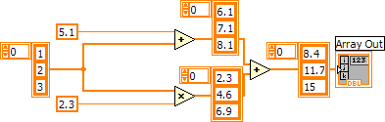
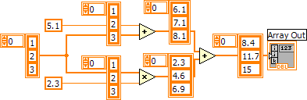


Wire Semantics
Every wire is a buffer
Branches create copies
Notes:
The value semantics of LabVIEW dataflow programming model mean each wire operates on its own copy of the data. SubVIs and built-ins also create copies of their data. The benefit of making copies is that two branches of code can operate independently on data. No locks required.

Slide 17
Optimizations by LabVIEW
The theoretical 5 copies become 1 copy operation.
Copy
Output is “inplace” with input
Notes:
Our previous example for value semantics indicated there could be as many as 5 copies of the array. In actuality LabVIEW examines the code and discovers two branches of code. The top branch is marked as needing a copy since it will destructively modify the array coming into the + operation. The bottom branch is optimized to use the same array for the output from the * operator and the + operator. LabVIEW has optimized the 5 copies down to 1 copy. The ideal solution because you would need to make a copy of the array regardless of the language since both branches want to write back into the array.
[NOTE: “copy” on this slide is a verb. Thus 5 copies uses 6 buffers, 1 practical copy requires 2 buffers]

Slide 18
The “In Place” Algorithm
Determines when a copy needs to be made
Weights arrays and clusters higher than other types
Algorithm runs before execution
Does not know the size of an array or string
Relies on the sequential aspects of the program
Branches might require copies
Notes:
The algorithm that determines when a copy needs to be made is called the “inplace” algorithm. The algorithm traverses the VI and tries to find the best way in which the code can be arranged to reduce the copying of arrays and clusters. The inplaceness is determined before execution and therefore doesn’t know if one array is larger than another.

Slide 19
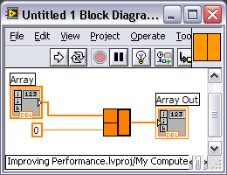
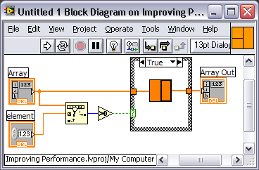

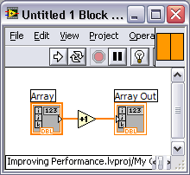
Bottom Up
In place information is propagated bottom up through the call hierarchy
Branched wire
Copy because of increment
No copies required
Increments array in place
Notes:
The algorithm that determines when a copy needs to be made is called the “inplace” algorithm. The algorithm traverses the VI and tries to find the best way in which the code can be arranged to reduce the copying of arrays and clusters. The inplaceness is determined before execution and therefore doesn’t know if one array is larger than another.

Slide 20
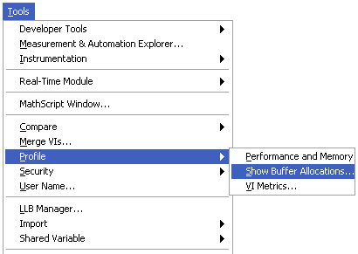
Showing Buffer Allocations
Notes:
The “Show Buffer Allocations” tool is located in Tools>Profile>Show Buffer Allocations…
<DEMO> Open up the block diagram to “0 – Main.vi” and show buffer allocations. Point out the dots which represent buffer allocations.

Slide 21
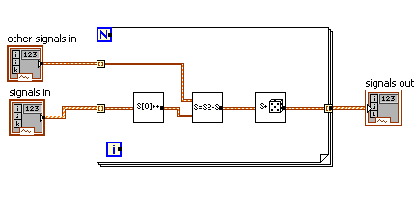
Example of In Place Optimization
Operate on each element of an array of waveforms
Notes:
Here is an example of how to use the Show Buffer Allocations tool to improve performance. Starting at a high level of your hierarchy you can use the Show Buffer Allocations tool to see that these waveforms are being copied three times. To optimize this we need to drill down into each of these SubVIs and fix them so that they operate in place.

Slide 22
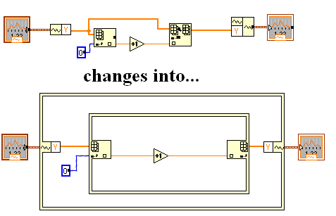
Make the first SubVI “in place”
changes into…
Notes:
Here we can make the subVI work in place by using the in place element structure. If your version of LabVIEW does not have the In Place Element Structure then you can get the same effect by wiring the input waveform into the top terminal of the bundle waveform node on the right (the so-called “magic pattern”). This gives LabVIEW’s in place algorithm a hint that you want those two waveforms to be in place.

Slide 23
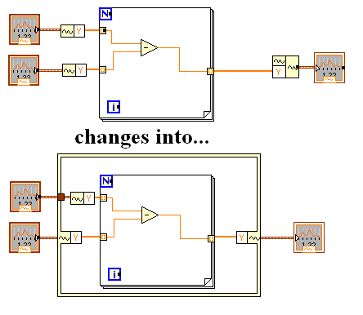
SubVI 2 is made “in place”
changes into…
Notes:
Again we can make the subVI work in place by using the in place element structure.

Slide 24
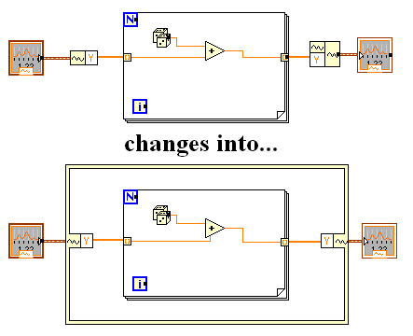
SubVI 3 is made “in place”
changes into…
Notes:
One more time we can make the subVI work in place by using the in place element structure.

Slide 25
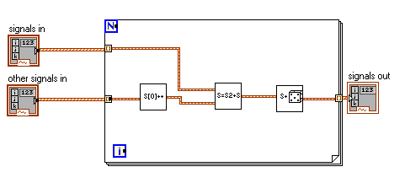
Final Result: Dots are Hidden
Notes:
Once you have visited each of these subVIs and fixed the copy then you can save them all (including the top level VI) and use the Show Buffer Allocations tool again to verify that the dots are gone. Remember that you have to recompile the Vis to update the buffer allocations display. You can do this by running the VI, saving it, or holding the Control key and clicking on the Run arrow.

Slide 26
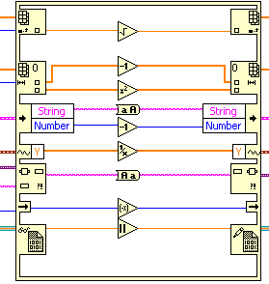
In Place Element Structure Nodes
Seven border node types:
Array index/replace
Array split/replace subarrays
Unbundle/Bundle cluster
Unbundle/Bundle waveform
Variant to/from element
In Place In/out border node
Data Value Reference Read/Write
Right-click left or right border to add nodes
Notes:
The In Place Element structure uses multiple border nodes to extract data from various data structures. These nodes are used to extract individual data points from data structures, including Arrays, Clusters, Waveforms, and Variants. In addition, the In Place In/out border node allows you to pass in single values for In Place operations.
If the code you write inside an In Place Element structure cannot be performed in place, LabVIEW makes a memory copy.
The Array split/replace subarray and Data Value Reference Read/Write nodes are new in LabVIEW 2009. The Data Value Reference is unique, and we will discuss that functionality later in this section.

Slide 27


Panel Data or Operate Buffers
Controls and indicators have their own copy of the data
Memory is not needed if the front panel is not in memory
Default data increases memory usage
Notes:
Front panel controls and indicators have their own copy of data so that front panel edits do not interfere with computations. In the example shown, Numeric +1 is meant to be in place with Numeric. If the front panel and block diagram shared this memory space, the front panel would have the same value as Numeric +1 after executing this code.
Some controls, such as charts and tables, have the ability to store large amounts of default data, which may increase memory usage. VI Analyzer includes a test to detect if this occurs in your application.
In the case of calling subVIs, you do not load the front panel unless needed. Instances in which subVI front panels are needed are discussed later in this lesson.

Slide 28
Transfer Buffers
Operate Buffer
Transfer Buffer
Execution Buffer
Transfer Buffers protect data transfer between Operate and Execution Buffers
Only updated if front panel is in memory
Copy
Copy
Notes:
To protect data transfer between the Operate and Execution Buffers, LabVIEW uses Transfer Buffers. This may lead to even more memory usage when you work with large data sets and you must show operation on that data. Transfer buffers and execution are discussed in Lesson 5, Optimizing for Execution Speed.

Slide 29

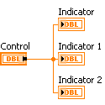
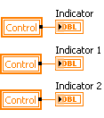
Local and Global Variables
Local variables update the data transfer buffer.
Reading a local or global variable always causes a data copy
Use wires to transfer data when possible
Notes:
Notice that in the example on the left, when wires are used to transmit data, only 1 buffer allocation is needed. If you read from the local variable of the control, a copy is made. In this example, three copies are made, one for each local variable read. Again, this is more significant if the local variable contains a large cluster or array. Note that this applies even if you are reading from and then writing to the same variable. Local variables can never operate in place because the local variable may refer to the transfer buffer, and you cannot be in place to a transfer buffer.

Slide 30
Local Variables vs. VI Server Property Node
Local Variables
Can run in any thread
Copies to/from transfer buffer
Writes cause second copy into operate buffer if front panel is in memory (avoid this if possible)
Use when speed is important
Property Nodes
Must run in UI thread
Copies to/from operate buffer
Writes cause second copy into transfer buffer
Force front panel in memory
Use when synchronous display is necessary
Avoid both if possible
Notes:
The rules listed here are explicitly for VI Server property nodes – they do not apply to property nodes used for DAQ, LV classes, etc.

Slide 31
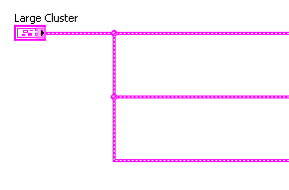
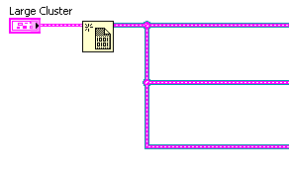
Data by Reference
Manipulate references to the data instead of the data itself
Data
Reference
Data Copy
Reference
Data Copy
Reference
Traditional dataflow: branches may create copies
By reference: points to memory location
Notes:
Branching a wire may result in a copy of the data on the wire. This is always true if more than one branch modifies the value, or if one modifies it before the other finishes using the original value. Data Value References (DVR) allow you to manipulate data without making copies. This is especially helpful when dealing with large arrays in performance-critical applications.
Consider this scenario: You e-mail friends to share videos with them. If you include the entire video in the e-mail, friends are annoyed because the file takes up space in their inbox. So, you include a link to the video location online. Because all recipients reference the same location online, everyone sees the latest version of the video in case it is modified.

Slide 32
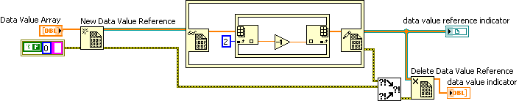
Data Value References
Act as references to data rather than full data itself
Can protect access to data
Notes:
The Data Value Reference, introduced in LabVIEW 2009, and single element queues are very efficient methods for transferring large data sets. You learn more about these constructs in Lesson 4, Optimizing for Memory, but they are worth mentioning because they are useful for moving large data sets throughout your VI hierarchy while minimizing memory usage. It is important to note that the In Place Element structure must be used to access the data of a Data Value Reference.

Slide 33
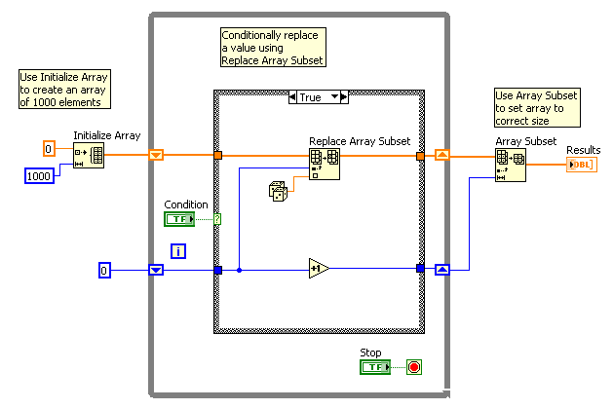
Memory Reallocation
Preallocate an array if you:
Conditionally add values to an array
Can determine an upper limit on the array size
Notes:
With While Loops, auto-indexing is not quite as efficient because the end size of the array is unknown. However, While Loop auto-indexing avoids resizing of the output array with every iteration by increasing the output array size in large increments. When the loop finishes executing, the output array is resized to the correct size. The performance of While Loop auto-indexing is nearly identical to that of For Loop auto-indexing.
Auto-indexing assumes that you will add a value to the resulting array with each iteration of the loop. If you must conditionally add values to an array but you can determine an upper limit on the array size, consider preallocating the array and using Replace Array Subset to fill the array.
After you fill the array values, you can resize the array to the correct size. The array is created only once and Replace Array Subset can reuse the input buffer for the output buffer. The performance of this code is very similar to the performance of loops using auto-indexing. If you use this technique, make sure that the array in which you replace values is large enough to hold the resulting data. Replace Array Subset does not resize arrays for you.
The example above shows this process.
Use the technique shown above to avoid an expensive memory reallocation. The Replace Array Subset function operates efficiently because it replaces the values in an array that was preallocated. The best way to prevent a memory reallocation is to determine how many elements will be in the array, and then allocate sufficient memory.

Slide 34
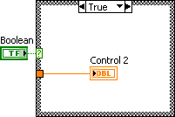
Conditional Indicators
An indicator inside a Case structure or For Loop
Prevents LabVIEW from reusing data buffers
Notes:
The way in which you build a block diagram may prevent LabVIEW from reusing data buffers. Using a conditional indicator in a subVI prevents LabVIEW from optimizing data buffer usage. A conditional indicator is an indicator inside a Case structure or For Loop. Placing an indicator in a conditionally executed code path breaks the flow of data through the system and LabVIEW does not reuse the data buffer from the input. Instead, LabVIEW forces a data copy into the indicator. The reason for this is that LabVIEW must pass default data to the indicator if the conditional path is not executed in order to update the indicator directly.
When you place indicators outside Case structures and For Loops, LabVIEW directly modifies the data inside the loop or structure and passes the data to the indicator instead of creating a data copy. You can create constants for alternate cases instead of placing indicators inside the Case structure.
In VI Analyzer, navigate to the Block Diagram»Performance tests. Enable the Wired Terminals in Subdiagrams test to identify conditional indicators in your code.
This is described in the VI Memory Usage topic of the LabVIEW Help.

Slide 35
Dataspaces
A VI’s data is stored in its dataspace
Each VI has its own dataspace
Reentrant VIs have multiple dataspaces

Slide 36
Reentrancy and Dataspaces
Non-reentrant
One dataspace shared by every call
Only one call can execute at a time
Lower memory usage
Can save state (e.g., for LV2-style globals)
Standard reentrancy, aka “Preallocate clones”:
Every call has its own dataspace
Calls never have to wait
Pooled reentrancy, aka “Share clones”
Added in LabVIEW 8.5
Each call pulls a dataspace from a shared pool
New dataspaces are allocated dynamically if needed
Calls never have to wait (except possibly to allocate a new dataspace)
Required for recursion
Notes:
When a VI is “reentrant” it can be called multiple times simultaneously. It can do this by duplicating the dataspace so that each concurrent call has its own copy. Prior to LabVIEW 8.5 we only had two settings for reentrancy: on or off. In 8.5 we added a new kind of reentrancy called “share clones”. If a VI is not reentrant then only one call may execute at a time because there is only one dataspace for that VI. This keeps memory usage lower, and it allows for the VI to save state between calls using uninitialized shift registers (the basis for LV2-style globals). When you mark a VI as reentrant the default is “Preallocate clones”. This means that every single call of that VI gets its own unique dataspace. As a result, a call never has to wait for another call. However, this can cause a large increase in memory usage if the VI is called many times and/or it has a large dataspace. This effect is multiplied if you have multiple VIs in a hierarchy marked as reentrant. There have been cases where someone marked every VI in their system as reentrant and ended up with thousands of clones of some VIs, which ultimately causes LabVIEW to run out of memory. Choose carefully which Vis you want to mark as reentrant: focus on those which are called often and called concurrently.
The new option for reentrancy is called “Share clones”, which internally we often refer to as “pooled” reentrancy. With this setting there is a pool of dataspaces for the VI, and each call gets a dataspace from the pool. If all of the dataspaces in the pool are in use then a new dataspace is created and added to the pool. This has some of the benefits of non-reentrant and fully reentrant Vis: memory usage is lower because you only need as many dataspaces as you have concurrent calls, and subVI calls do not have to wait for other calls to finish. However, they may have to wait to allocate a new dataspace. The downside is that any state stored in the VI (for instance, in shift registers) is associated with the dataspace, and each call may get a different dataspace. This makes shared reentrancy a bad idea for globals.
When using recursion you must configure the recursive VI to use shared clones. This allows each recursive call to have a fresh dataspace so that it never blocks and doesn’t use infinite memory.

Slide 37
Dataspace Contents
A single large block of data
Execution system queue element structures
Execution data
Wires
Temporary data
Shift registers

Slide 38
Dataspace Contents
Two types:
“Top-level”
Directly stored in the dataspace
Numerics, clusters, array and string handles, etc.
“Hair”
Not stored directly in the dataspace
Referred to by a top-level allocation
Can be variable length
Array and string contents
Notes:
When considering the contents of the dataspace it is sometimes important to distinguish between two types of data in the dataspace. Top level data is the data that is stored directly in the dataspace. For instance, every numeric in the dataspace is a simple allocation in the dataspace taking up as many bytes as needed for that number. Clusters are also stored directly in the dataspace. However, some types of data are not stored directly in the dataspace. Most notably, array and string contents are not stored in the dataspace. Instead, the dataspace itself contains a pointer to the actual data, which is stored somewhere else. This is done so that the data can be variable sized.
This is important because when you use the “show buffer allocations” too you are seeing only top-level allocations. The dots represent an allocation directly in the dataspace. They do not show when an array is resized in place, and sometimes you will see an allocation which is only used in error cases. That is, not ever buffer allocation dot is a performance problem, and not every performance problem caused by allocations will show up as a buffer allocation dot.

Slide 39
LabVIEW Cleanup
LabVIEW cleans up many references when the owning VI goes idle and others when the process closes
Manually close references to avoid undesirable memory growth, particularly for long-running applications.
Notes:
LabVIEW automatically closes references when the top level VI of the hierarchy that opened the reference (owning VI) goes idle, or when LabVIEW exits. Some reference types that close when the owning VI goes idle are file references, queues, and ActiveX references. Other references, such as VISA and IVI, are not closed until LabVIEW exits.
It is still a good idea for you, as a programmer, to close references during execution for several reasons. If you have a long-running program, opening references repeatedly without closing them may cause a memory problem because each reference requires memory. Also, any references related to external code should be closed manually to ensure that the close process is performed in a specific order to avoid crashes and other possible corruptions. In most other development environments, failing to close references commonly results in a crash or memory leak when you close your application.

Slide 40
Memory Usage of the User Interface
Every control on the UI requires memory in order to store the data structure
At run time, Control and Indicator data is additional copy of block diagram data
Default data for controls may contribute to unnecessary memory usage
SubVI UIs generally do not contribute to memory usage
Notes:
One of the most overlooked areas of memory usage in LabVIEW is the front panel. LabVIEW must allocate sufficient memory to store all of the data structures and default data when the front panel is loaded. Each control contains a separate copy of the data on the block diagram, so memory-intensive applications should avoid displaying large amounts of data, unless needed, to avoid running out of memory.
If you have a very large front panel with very large controls, such as an array with 30,000 elements, then that front panel requires more memory in order to load. Large default data may contribute to increased memory usage and slower load times. Use the Array Default Values test in the VI Analyzer toolkit to identify situations in which default data unnecessarily contributes to memory usage. Avoid creating a single, monolithic front panel for your top level VI. Combining features, like the Subpanel control and dynamically loaded VIs, reduces the memory usage of an application when used properly.
SubVIs do not typically load their front panel into memory, unless it is needed or manually loaded, so the memory usage of a subVI’s front panel is not usually a contributor to application memory usage.

Slide 41
SubVIs and Memory Usage
The execution system makes a copy of the control and indicator data of the subVI under the following conditions:
The front panel is in memory
The front panel uses data printing
The block diagram uses Property Nodes that reference front panel controls/indicators
The VI uses local variables
The front panel uses data logging
Notes:
If a subVI is called, only its compiled code is loaded into memory, unless the front panel is required for execution. The front panel may be in memory for a variety of reasons. Several of these items require the front panel in memory in order to function properly. It is also possible that you configured the subVI to open the front panel when called.
In the Operate menu, you can enable Print at completion and Log at completion.

Slide 42

Tips for reducing memory usage
Operate on data in place
Do not overuse reentrant settings
Close references to avoid leaks
Avoid operations which require the front panel to be in memory
Ex: Control references
Save the VI and close the front panel before running
Avoid large default data in arrays, graphs, etc.
Only display information on the front panel when necessary
Request Deallocation Primitive

Slide 43
Memory Fragmentation
1.6 GB
0.4 GB
Reported
0.34 GB
0.16 GB
0.42 GB
0.38 GB
0.3 GB
Actual
Used
Available
0.1 GB
0.16 GB
0.14 GB
Notes:
It takes time for the memory manager to allocate and deallocate memory, which slows execution. In some cases, Out Of Memory errors occur even when you assume that you have adequate available memory.
This slide shows the difference between the actual memory layout and the reported aggregate values. In this case, even though it is reported that 0.4 GB of memory are available, the available memory is not actually adjacent, as shown in the Reported diagram. Instead, the available memory is fragmented as shown in the Actual diagram. The largest available contiguous memory is actually 0.16 GB in size. The more fragmented memory becomes, the more difficult it is for the memory manager to allocate and deallocate, and repeated allocations slow execution.

Slide 44
General Benchmarking tips
Disable debugging
Save all
Close all unnecessary front panels
Notes:
There are a few important things to keep in mind whenever you are benchmarking so that you can get meaningful results. First, disable debugging on the Vis you are benchmarking unless you specifically want to benchmark them with debugging on. Second, save all of your Vis before you start benchmarking. If a VI has unsaved changes then its front panel and block diagram may not be able to leave memory, which can cause the VI to do extra unnecessary work to update the front panel. Remember that even if a front panel is not visible it may still be in memory if the VI has unsaved changes. Once all Vis have been saved you should close all unnecessary front panel windows. Any opened front panels will cause the executing code to spend extra time updating the front panel which will have a very significant impact on performance.

Slide 45
Questions

Slide 46
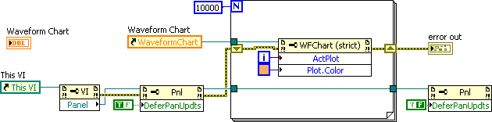
Defer Panel Updates
Defer panel updates when performing multiple control property changes
Avoid wiring error in on a node that enables panel updates in order to avoid a UI hang if error occurs before the node
Notes:
Some property changes trigger a redraw by default. You can defer this redraw using the Defer Panel Update Property Node as repeatedly redrawing the front panel can be very time consuming. When making several updates at once, defer panel updates until all changes are made. When you set this property to TRUE, LabVIEW redraws any front panel objects with pending changes, then defers all new requests for front panel updates.
For example, controls and indicators do not redraw when their properties or values change. If the operating system requests a redraw, like when the window is no longer behind another window, LabVIEW redraws the front panel with the current properties instead of the original properties. If FALSE, LabVIEW immediately redraws the changed elements of the front panel.

